Slide 1
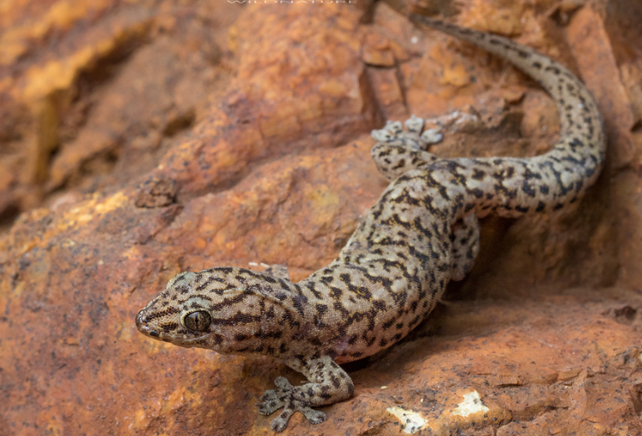
Exercise “Western Tree Dtella”
Dalwallinu LEMC and Water Corporation Desktop Exercise

Slide 2
Welcome and Introductions

Slide 3
Site Information

Slide 4
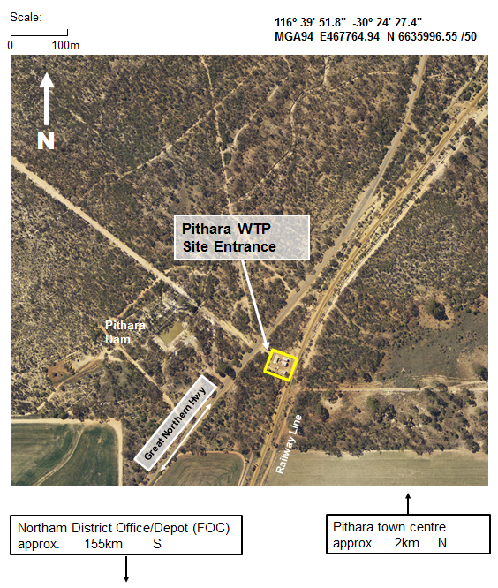
Pithara Water Treatment Plant (WTP) Site Information
Pithara WTP is located off Great Northam Highway in Pithara.
The site address is Reserve 24671
Great Northern Highway
PITHARA WA 6608
Site Coordinates are:
longitude 116º 39’ 51.8” and latitude -30º 24’ 27.4”

Slide 5
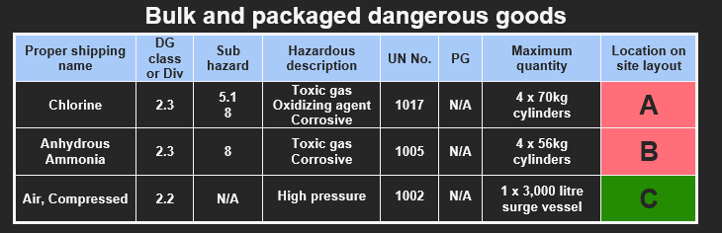
Pithara WTP Contains

Slide 6
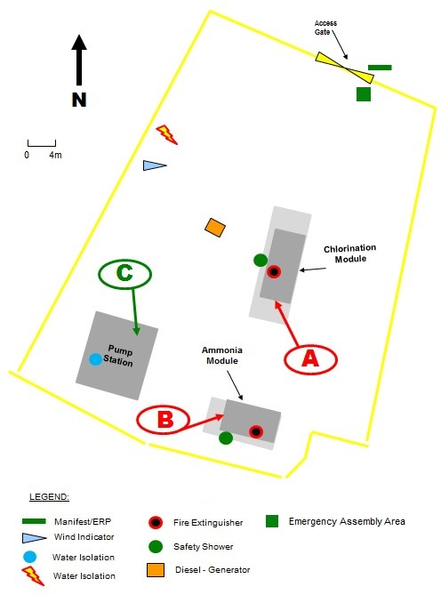
Pithara Site Map

Slide 7
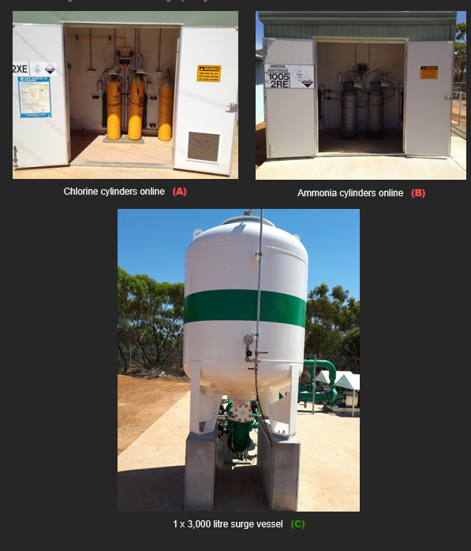
Pithara Dangerous Goods

Slide 8
Chlorine

Slide 9
Characteristics of Chlorine Gas
Penetrating and irritating Odor
Greenish yellow in colour
Chlorine is 2.5x heavier than air and will follow the contours of the ground and will rest in low lying areas

Slide 10
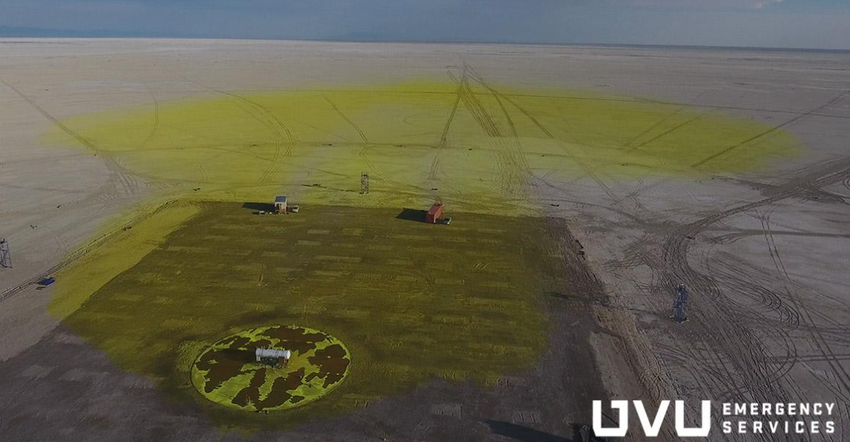
Photo of Chlorine Gas Release

Slide 11
Effects of Chlorine
Chlorine gas can have severe effects on the body when inhaled. It irritates the respiratory system, leading to coughing, chest tightness, difficulty breathing, and potentially fluid build-up in the lungs.
In higher concentrations, it can cause pulmonary edema (fluid in the lungs) and even death.
Additionally, chlorine gas exposure can irritate the eyes, skin, and mucous membranes, leading to burning sensations, redness, and potentially permanent damage.

Slide 12
Acute Exposure Guideline Levels (AEGL)
AEGL-1: is the airborne concentration of a substance above which it is predicted that the general population could experience notable discomfort, irritation or certain asymptomatic, non-sensory effects. However, the effects are not disabling and are transient and reversible upon cessation of exposure.
AEGL-2: is the airborne concentration of a substance above which it is predicted that the general population could experience irreversible or other serious, long-lasting adverse health effects or an impaired ability to escape.
AEGL-3: is the airborne concentration of a substance above which it is predicted that the general population could experience life-threatening health effects or death

Slide 13
Any questions?

Slide 14
Exercise “Western Tree Dtella”
Dalwallinu LEMC and Water Corporation Desktop Exercise

Slide 15
Pithara Exercise Brief
Initial Situation
At 1600hrs on the 4th of May 2026 a Water Corporation Site Manager is called by the Water Corporation Operations Centre to investigate an 18-ppm chlorine leak at the Pithara WTP.
Considerations:
Weather 22C Wind ESE at 19kmph

Slide 16
Water Corporation Initial Action
The operations manager dispatches two operators to site. On arrival at site the operators don the correct PPE and investigate the leak. The investigations revel that the chlorine cylinder valve has been damaged and can’t be isolated.
This is escalated to DFES as the HMA.

Slide 17
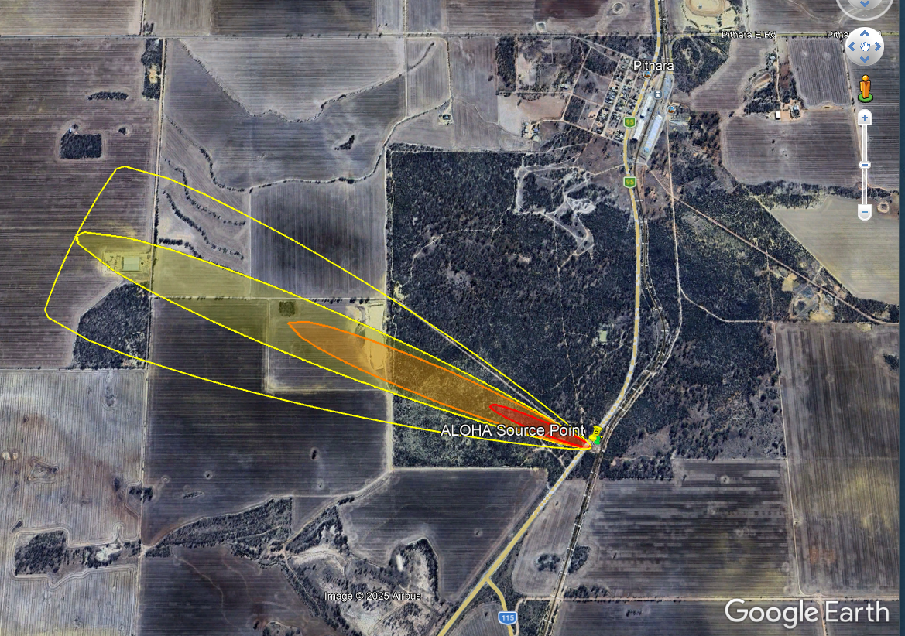
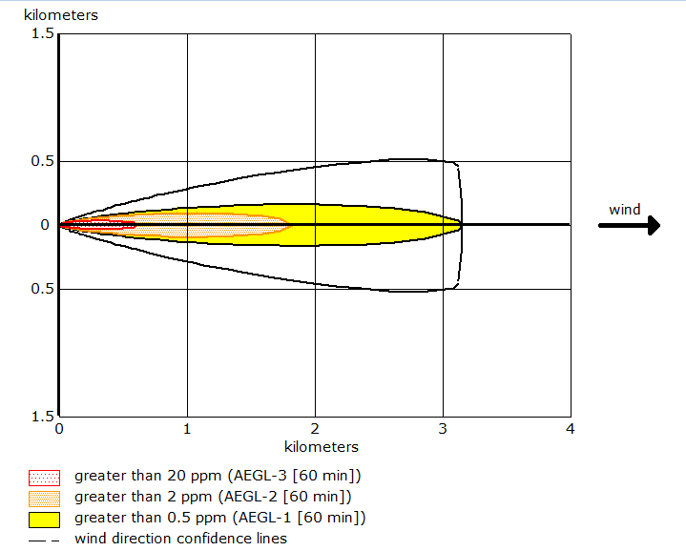
Chlorine Leak Map

Slide 18
Response
How would your agency respond to this situation?
Would you start to stand up an IMT?

Slide 19
Response
Two school buses are returning from an interschool sports carnival and can’t get through due to the road being closed.
How would you respond to this?

Slide 20
Recovery
It has all been made safe and DFES have returned it back to the Water Corporation. What needs to be done to return it back to normal?

Slide 21

Debrief
Dalwallinu LEMC and Water Corporation Desktop Exercise

Slide 22
Thank You For Your Participation

